Slide 1
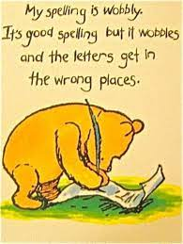
Spelling

Slide 2
National Curriculum
• Spelling patterns and examples of words. These are non-statutory.
• Common exception words.
• Word-lists for years 3 and 4 and years 5 and 6 are statutory.
• Phonic knowledge to continues after Key stage 1.
Example: medical and medicine
The /s/ sound in medicine is spelt with the letter c.
• Relationships between meaning and spelling.
• Prefixes and suffixes.
Notes:
Tested in Year 6 – give examples of the test
Spelling helps children to write more easily – they often ask – how do I spell… but this slows them down. Knowing the spelling or a best guess reduces the amount they are thinking about and frees them to focus on their writing.

Slide 3
How do we teach spelling?
Weekly list of focus words used for teaching focused around a rule e.g. drop the ‘e’ add ing
Spelling displays in classrooms that are updated with each rule
Daily spelling sessions from Years 2-6
We teach spelling using varied activities including:
Dictation
Investigations:
What happens when we add any of the suffixes -ment, -ness, -ful, -est, -ed to happy, lazy, hungry, ready, empty?
What do you notice?
Sorting spellings
e.g. singular and plural word cards into groups.
The children then explain how they have grouped them, giving their reasons.
Silly Sentences
Find the exception!

Slide 4
Other ways to learn spellings
Words within words e.g. Together – to get her
Mnemonics Because – big elephants can always understand small elephants. Said – silly ants in dresses
Say it like a robot! E.g. Wed-nes-day, choc-o-late

Slide 5
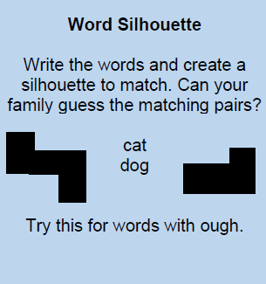
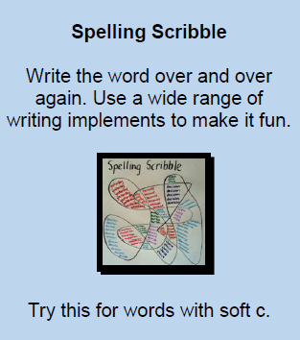
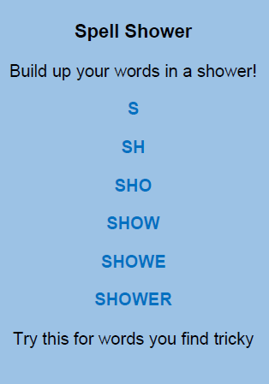
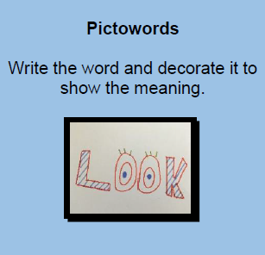
Helping with spelling at home

