Slide 1

Welcome to Kinetic Letters handwriting!

Slide 2

Kinetic letters is a programme which teaches children how to form letters correctly, quickly and with confidence.
As handwriting becomes more fluent, children think less about handwriting allowing more time to think about the content of writing.
Handwriting becomes automatic.

Slide 3
How do we teach handwriting?
There are 4 strands to kinetic letters which we work through
Red –making bodies stronger (this is ongoing)
Green –holding a pencil correctly
Yellow –letter formation
Blue –writing with fluency (speed)

Slide 4
Importance of Physical development
Handwriting requires more than just hand muscles.
Strong core muscles allow children to sit at tables correctly and be comfortable when writing.
Strong shoulder muscles allow children to control the lower parts of their arm
Strong wrists enable children to hold the pencil correctly

Slide 5
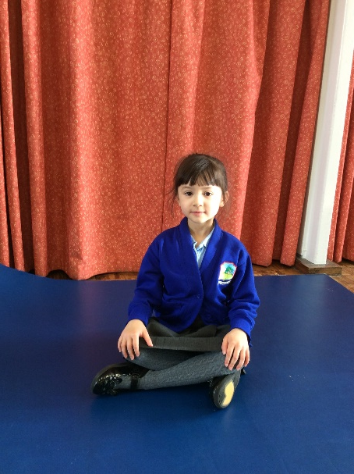
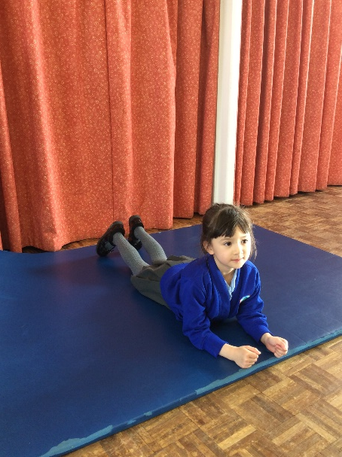
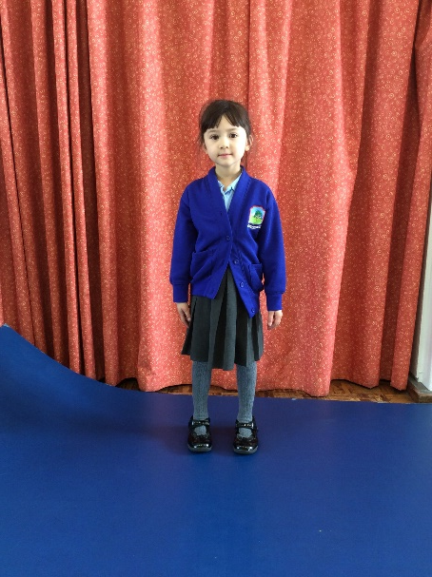
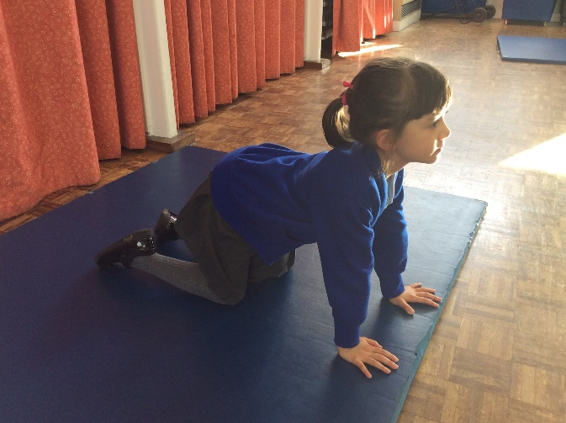
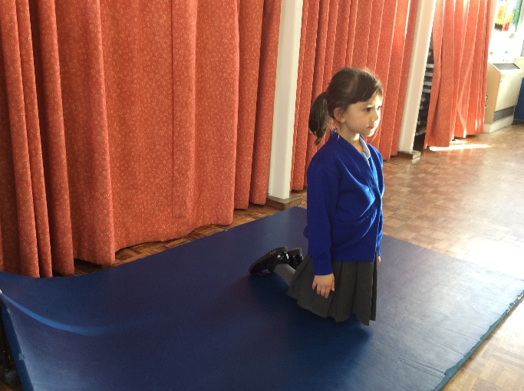
Animal poses we use at school to make bodies stronger
Gorilla
Lizard
Penguin
Meerkat
Stone Lion

Slide 6
Helping at home with strengthening bodies for handwriting
here are lots of opportunities to make bodies stronger at home using these poses.
Reading stories – Gorilla pose/Lizard pose
Play board games/consoles – Lizard pose
Ipad – Gorilla pose/Lizard pose
Watching TV – Gorilla pose/Lizard pose

Slide 7
Other opportunities to make bodies stronger
Monkey bars
Pulling themselves up on equipment at the park
Clapping games
Crawling through tunnels or crawling games

Slide 8
Pencil Hold
We teach the children the “three friends hold”.
The third finger is called the pillow finger and
it sits underneath the pencil
The thumb and first finger sit on top of the pencil

Slide 9
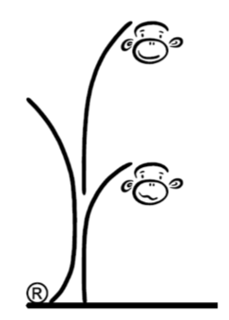
How do we learn our letters?
Letters are grouped into letter families.
Each letter family is introduced to the children through a story about two monkeys called bounce and skip.
Bounce is a brave monkey and helps write the tall letters whilst skip is a scared monkey and helps write the other letters.

Slide 10
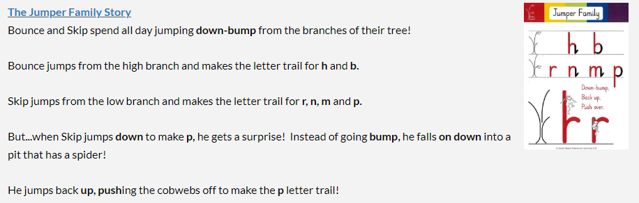
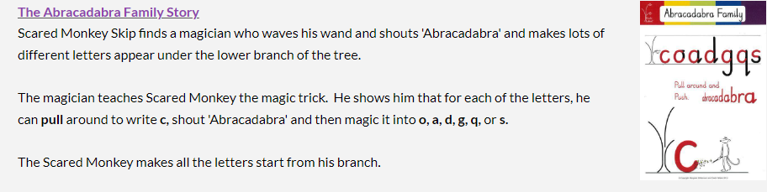

Slide 11
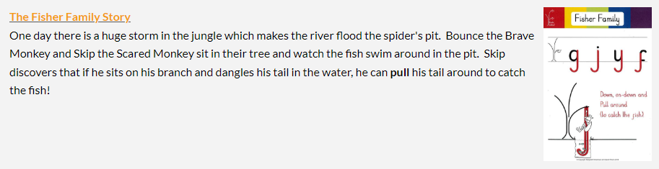
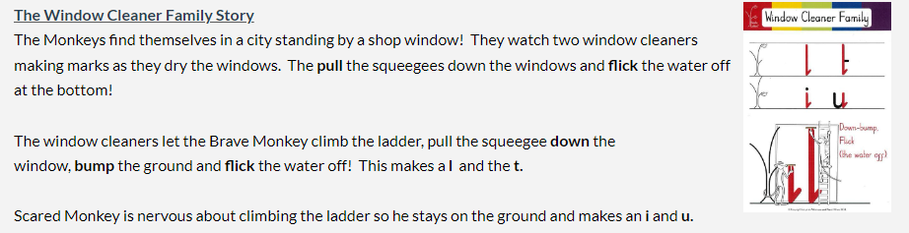

Slide 12
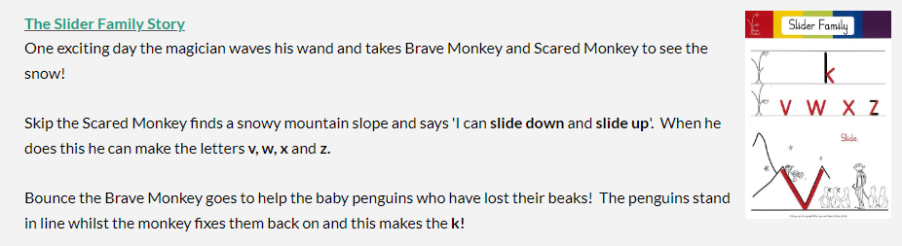
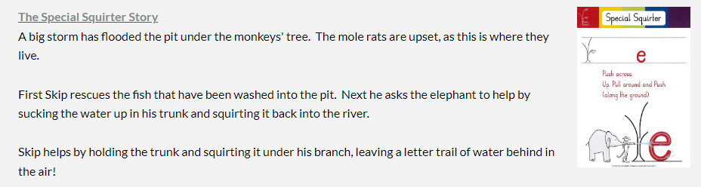

Slide 13
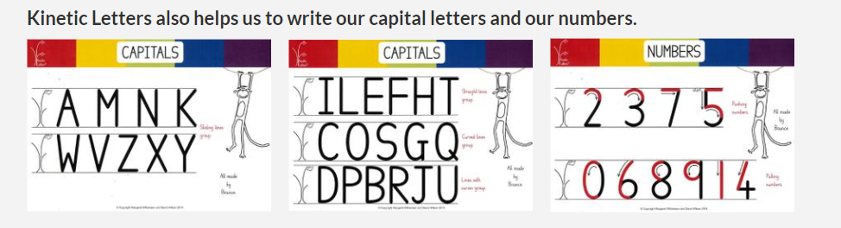

Slide 14
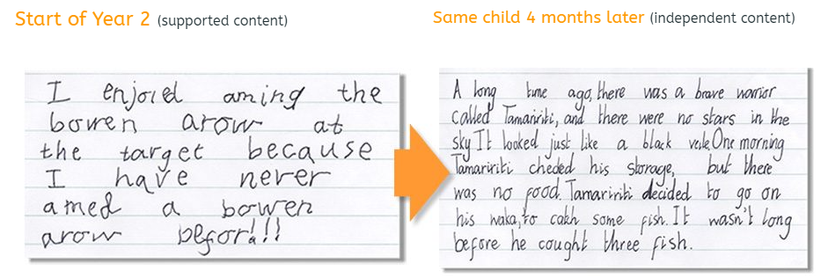
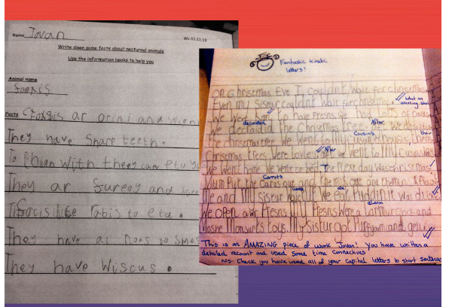
Why are we using Kinetic Letters?

