Slide 1


Uplands Primary School
RSHE (Relationships, Sex and Health Education)
Updates to the Curriculum
Notes:
Hello, and welcome to a short presentation that will briefly outline the new statutory updates to our PDL curriculum. RSHE stands for Relationships, Sex and Health Education and is an integral part of our PDL (Personal Development Learning) curriculum. Last year, the government introduced some statutory updates to the curriculum that are in line with our evolving, modern society and way of living. We have put this presentation together, along with an FAQ document that can be found on our website, to support parents in feeling well informed about what we are teaching at Uplands.

Slide 2
Why do our children need an RSHE curriculum?
We want to prepare our children for a happy and successful life beyond the classroom.
We want to give children the building blocks to understand healthy, respectful relationships (focused on family and friendships)
Our children’s happiness is a priority – teaching them about living a healthy and happy life will support children in looking after their own wellbeing and knowing how to seek support and help if they need it.
It supports our Uplands’ values of kindness, creativity, resilience and respect and promotes living a happy, successful life within the community.
Notes:
Our children and young people are growing up in an increasingly complex world which features both online and offline activities. This presents many positive, exciting opportunities but not without challenges and risk. We have a responsibility to teach our children how to be safe and healthy and how to manage their academic, personal and social lives in a positive way.
For our primary aged learners, we want to build the foundations for understanding healthy, respectful relationships, focusing on family and friendships (in all contexts, including online). This sits alongside the essential understanding of living a healthy life – both physically and mentally. Teaching about mental wellbeing is central to these subjects – our children’s happiness is a priority. The new RSHE subject content will give our children the knowledge and capability to take care of themselves and seek support appropriately if needed.
The RSHE curriculum forms an integral part of our teaching at Uplands, where we foster pupil wellbeing and develop resilience in order to support our children in being happy, successful, confident members of our community. It is coupled with our school values that promote kindness, creativity, resilience and respect.

Slide 3
Legal documentation and supporting documents
Schools must comply with the below –
The Equalities Act 2010
Keeping Children Safe in Education (Safeguarding)
Statutory Guidance: Relationship, Health and Sex Education (June 2019)
OFSTED Guidance.
Green Paper: Mental Health and Wellbeing.
British Values: Democracy, Mutual Respect, Rule of Law, Individual Liberty, Tolerance of others
National Curriculum: Science
Notes:
We have a duty of care to all of our pupils and the following curriculum document has been put together with significant consideration for the above documents.

Slide 4
Our curriculum here at Uplands
We follow the Government recommended scheme of work provided by the PSHE Association.
You can read through the guidance, schemes of work and resources on their website: https://www.pshe-association.org.uk/curriculum-and-resources
Following this scheme, we have separated our teaching into 3 categories:
Relationships
Living in the Wider World
Health and Wellbeing
Notes:
So what will RSHE look like here at Uplands?
We have decided to use a highly recommended programme of work from the PSHE Association. This is widely used by many schools across Hampshire and across the UK and is recommended by the DfE, as well as our local Hampshire advisors. We felt that this programme of study closely matched our values at Uplands, as well as offering the coverage required by the National Curriculum.
Our teaching across the primary phase can be categorised under three subheadings, which remain the same throughout KS1 and KS2. Throughout each year, we will teach units focused on Relationships, Living in the Wider World and Health and Wellbeing. We will look at what these cover as the presentation continues.

Slide 5
Relationships
The primary focus of our relationships teaching looks at friendships, family relationships and relationships with other children and adults in a range of contexts.
What is a relationship? What is a friendship? What does family mean? Who are the people who can help us?
Treating each other with kindness, respect and consideration.
Characteristics of a healthy friendship, family relationships
Relationships online
Children understand that there are a range of family backgrounds and children experience different home circumstances.
Develop a range of personal attributes that support the development of successful relationships with others.
How to recognise and report concerns or abuse and where, and when, to seek advice if needed.
Notes:
The primary focus of our relationships teaching looks at the fundamental building bricks and characteristics of positive relationships; we explore in particular friendships, family relationships and relationships with other children and adults.
In Early Years and KS1, this starts with teaching about what a relationship is; what friendship is, what family means and who the people are who can support them. As children progress through the school, we teach children to take turns, treat each other with kindness, consideration and respect; we explore the importance of honesty and truthfulness, permission seeking and giving, and the concept of personal privacy. We support children in establishing personal space and boundaries – how to show respect and recognise the difference between appropriate and inappropriate contact. (This forms the foundation of understanding about consent – which is taught further down the line at secondary).
Respect for others is taught in an age appropriate way; we teach it through understanding our own and others’ boundaries through play, and through negotiations about space, toys, books, resources etc.
The features and characteristics of healthy friendships, family relationships and other relationships our young people will encounter are referred to explicitly throughout our teaching. By discussing them within a range of contexts supports our children in developing a strong, early understanding of the types of relationships that are likely to lead to happiness and security. This helps them also to recognise any less positive relationships if they encounter them. These principles of positive relationships also apply online; we are aware that as our children move through primary school, many are already accessing the internet. This is where our PDL curriculum and our Computing curriculum work seamlessly together to address online safety and appropriate behaviour online (in a way that is relevant to our pupils’ lives).
We are proud of the way our staff know our children and know our families. We want to reflect a range of family backgrounds within our teaching ( for example, single parent familes, LGBT parents, families headed by grandparents, looked after and adoptive parents amongst many others.) Our teaching sensitively reflects the fact that some of our children have very different home circumstances and they also may have a very different structure of support around them.
Our relationships teaching also enables children to develop personal attributes such as honesty, integrity, courage, kindness, trustworthiness and a sense of justice whilst understanding the importance of self-respect and self-worth. It gives us an opportunity to enable pupils to understand how friendships can support mental wellbeing.
Through our Relationships Education, we teach our children the knowledge they need to recognise and report abuse (including emotional, physical and sexual abuse) in an age appropriate way. We support children in recognising boundaries within friendships and families and how to report concerns and seek advice if they need.

Slide 6
Living in the Wider World
What does it mean to be part of the community? Children learn about different roles and responsibilities within societies and groups.
The value of rules and law.
Valuing diversity in the community.
Digital media – using devices safely, understanding the role of the internet and how it is used.
Notes:
We want our pupils to leave us with a confident understanding of the wider world and how to be happy and successful within it.
Our teaching about the wider world covers what it means to be part of a community and places valuing diversity at its core. In KS1 we look at being a part of a group, such as our classes, school and extra-curricular clubs and groups. We look at different roles and responsibilities within these group. In KS2 we explore the value of rules and laws, as well as discussing human rights and the freedoms and responsibilities we have in the UK. Throughout all of our teaching about the community we look at things that are the same and things that are different within our community. In Year 5/6 we explore stereotypes and we consider how discrimination can be challenged. Throughout the primary phase, we look at caring for our environment.
We look at digital media and resilience where children learn about using digital devices safely and begin to consider the safety and protection of data. As children progress through the school, they deepen their understanding of the internet and the different ways it is used.
We also look at money and work beyond school. This starts in KS1 where we introduce the idea of money – we look at what money is and discuss looking after money. We also consider personal interests and start to make connections to jobs within the community. As we move into KS2 we look at making decisions about money and expand our understanding of a range of jobs. Children start to explore job stereotypes and how we can challenge these stereotypes.

Slide 7
Health and Wellbeing
The characteristics of good physical and mental wellbeing
The benefits and importance of exercise, nutrition and sleep.
Understanding and articulating a range of emotions
Personal hygiene
Basic first aid
Benefits on our health that come from socialising
The impact of the internet and electronic devices on our health and wellbeing.
Notes:
We focus on teaching the characteristics of good physical and mental wellbeing. We recognise and teach that mental wellbeing is a normal part of every day life, just as physical health is.
In EYFS and KS1 we start to explore the benefits and importance of daily exercise, good nutrition and sufficient sleep – giving pupils the language and knowledge to understand the normal range of emotions that everyone experiences. This supports children in articulating how they are feeling and use language to talk about their bodies, health and emotions. As we progress through the school, children learn about ways to protect and support their own, and others’, health and wellbeing – including personal hygiene, prevention of health and wellbeing problems and basic first aid.
Throughout the year groups we explore the benefits of hobbies, interests and participation in our own communities. We explore how opportunities to spend time with others, including in organised and structured activities (such as sports clubs, scouting, guiding etc) are beneficial to our health and wellbeing.
In KS2 pupils are taught about the benefits of spending limited time online and about the risks of excessive use of electronic devices. In Year 5/6 we also look at why social media and games have age restrictions and we equip pupils to manage common online difficulties.
APPENDIX B – curriculum on what pupils need to know by the end of primary school

Slide 8
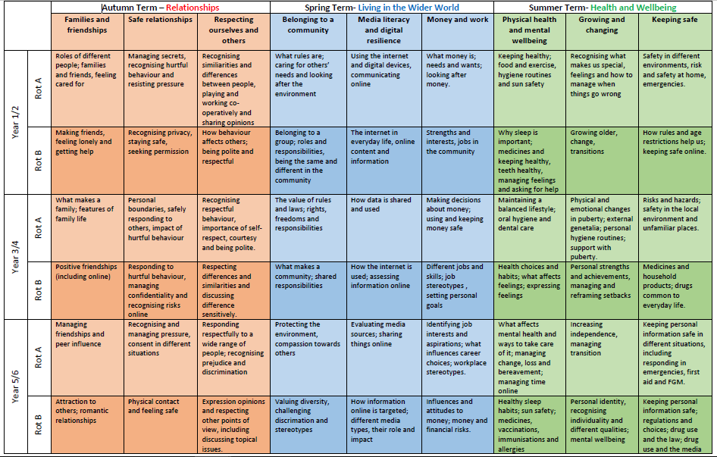
Notes:
This document is available on our school website and details what will be covered in each year group. We would like to share the long term curriculum map with you so that families at home are well informed and aware of what we are teaching in school. As a vertically grouped school, we have mapped out the units to follow our 2 year rotation plans. We acknowledge that some units, such as our SRE units, are more age sensitive, so these will continue to be taught in separate year groups at the appropriate time. We recognise that within our school community, all of our children are different; they have different backgrounds and different experiences of some of the above topics. Topics will always be covered in a sensitive manner and parents are always welcome to raise any individual concerns with their child’s class teacher.

Slide 9
Sex Education
Age appropriate
Based on needs of our pupils
Progressive
Inclusive
Delivered by trained staff in a safe environment
Prepares children adequately for puberty in a timely way
Prepares children for adult life
Promotes positive relationships
Notes:
Sex education forms part of the Health Education part of RSHE and runs parallel to our statutory science curriculum. Our sex education content will not be changing and we will continue to keep parents well informed in advance of the content that is taught. Sex Education at Uplands will always be age appropriate and based on the needs of our pupils. It will be progressive and support children as they grow and mature and it will always be inclusive for all pupils. SRE will always be delivered by trained staff within a safe environment – for some sessions we will separate the children into their respective year groups and may carry out some sessions where boys and girls are taught separately. Our SRE units are designed to prepare children adequately for puberty at an appropriate time, as well as preparing our children for later adult life. Fundamentally, our SRE teaching complements all of our units promoting positive relationships alongside safe and healthy living. There will be separate parent information sessions in advance of all sex education teaching in the relevant KS2 year groups.
Topics covered that are related to the Science National Curriculum are statutory and not optional to teach.

Slide 10
Science Curriculum
Year 1:
identify, name, draw and label the basic parts of the human body and say which part of the body is associated with each sense.
Year 2:
notice that animals, including humans, have offspring which grow into adults
(Non-statutory note: Pupils should be introduced to …the processes of reproduction and growth in animals. The focus at this stage should be on questions that help pupils to recognise growth; they should not be expected to understand how reproduction occurs)
Year 3/4
No mention on the science curriculum linked to puberty or reproduction
Notes:
The following slides outline any units that will be covered as part of the statutory science curriculum
In KS1, the science curriculum requires the following objectives to be taught.
IN Year 3/4 there are no objectives linked to puberty or reproduction on the science curriculum

Slide 11
Science Curriculum
Year 5/6
describe the differences in the life cycles of a mammal, an amphibian, an insect and a bird
describe the life process of reproduction in some plants and animals
(Non-statutory note: Pupils should find out about different types of reproduction, including sexual and asexual reproduction in plants, and sexual reproduction in animals)
describe the changes as humans develop to old age.
(Non-statutory note: Pupils should draw a timeline to indicate stages in the growth and development of humans. They should learn about the changes experienced in puberty.
Pupils could work scientifically by researching the gestation periods of other animals and comparing them with humans; by finding out and recording the length and mass of a baby as it grows)
recognise that living things produce offspring of the same kind, but normally offspring vary and are not identical to their parents
Notes:
In Year 5/6 the science curriculum requires the following objectives to be taught.

Slide 12
Right to be excused (previously known as the right to withdraw)
All parents have the right to withdraw their child from all non-statutory components of sex education. Relationships and Health Education and the Science curriculum are statutory and parents do not have the right to withdraw their child from these sessions.
All requests to withdraw your child should be put in writing to Mrs Ackerman, our Headteacher.
We will always work collaboratively alongside parents to discuss concerns.

Slide 13
Parental involvement
On our website you will find a document “Primary Programme Builder”. You can use this document to explore the units and objectives that will be covered in each phase, as well as look at the supporting resources that will be used within the teaching sessions.
Some examples are included on the following slides.
Please take some time to look through the content that will be taught in your child’s year group.

Slide 14
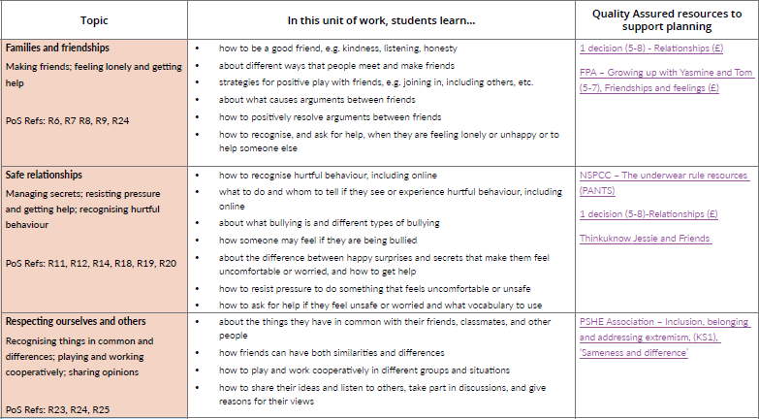
Year 1/2
Notes:
An example of some of the Relationships objectives covered in Year 1/2 and the resources that support this planning.

Slide 15
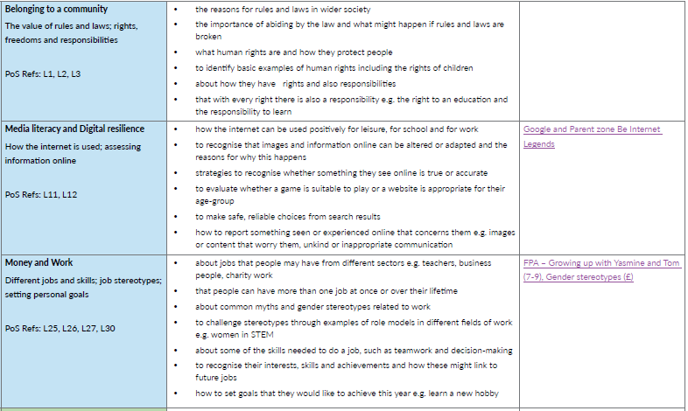
Year 3/4
Notes:
An example of some of the units covered in Year 3/4 linked to Living in the Wider World and their supporting resources.

Slide 16
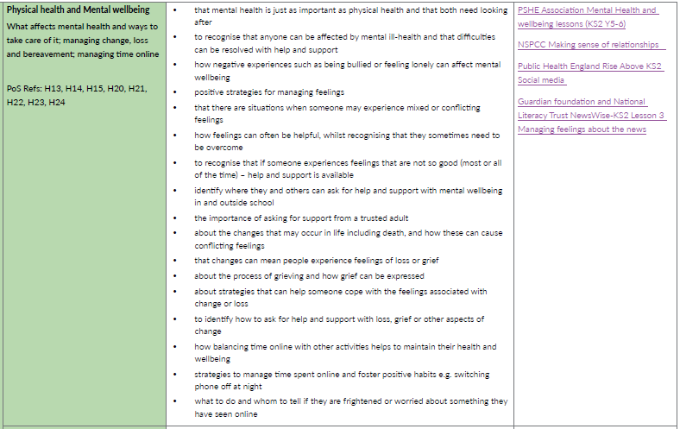
Year 5/6
Notes:
A unit covered in Year 5/6 about Health and Wellbeing with the attached resources.

Slide 17
Feedback
Thank you for your initial responses to our questionnaire shared last term.
Please refer to our FAQ document on the website with regard to the changes being made to our RSHE and PDL curriculum.
We remain in a period of consultation until the end of the Spring Term. We welcome parent feedback on our draft policy, attached curriculum map or any concerns you may have. Please email the school office (adminoffice@uplands.hants.sch.uk) with “RSHE Consultation” as the subject.
Notes:
Thank you to all who responded to our parent survey last half term. It was really useful to hear parents input and reflections and we hope to be able to address any concerns. We have put together an FAQ document to address some of the common concerns that arose.
We value the input and discussion of our parents and we remain in a period of consultation until the Easter holidays. Although the Relationships and Health curriculum is statutory, your views and concerns will always be listened to.

