Slide 1
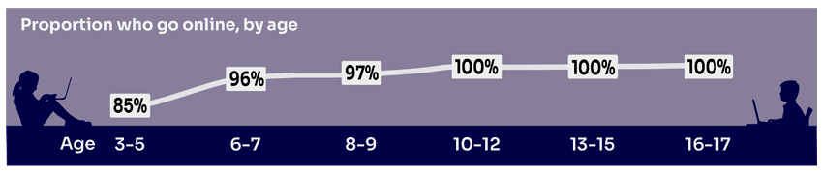
Staying safe online

Slide 2
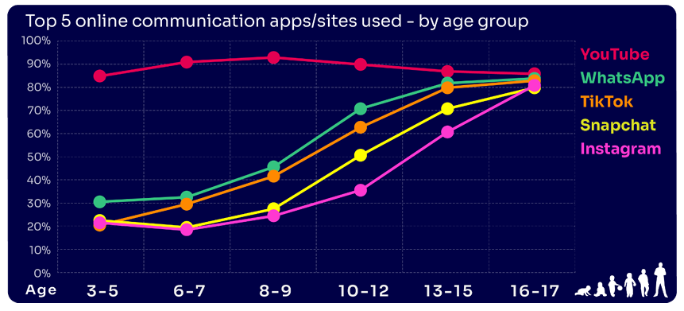
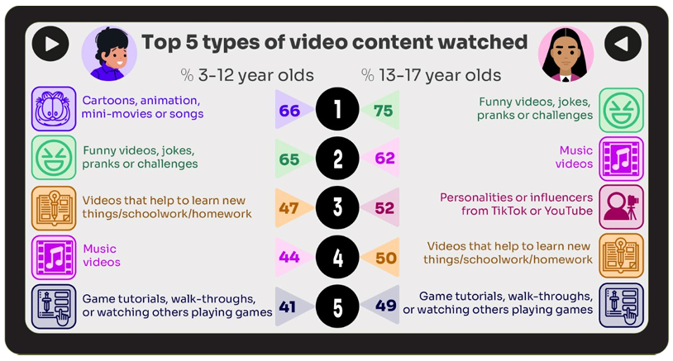
What do children use the internet for?

Slide 3
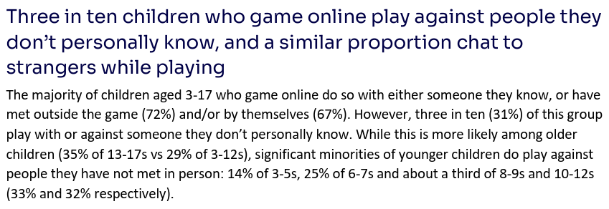
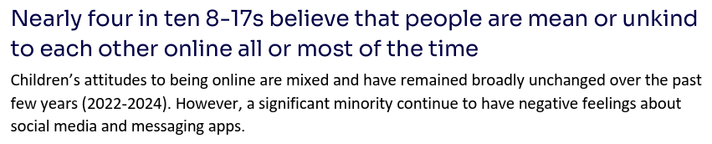
What are our concerns about being online?

Slide 4
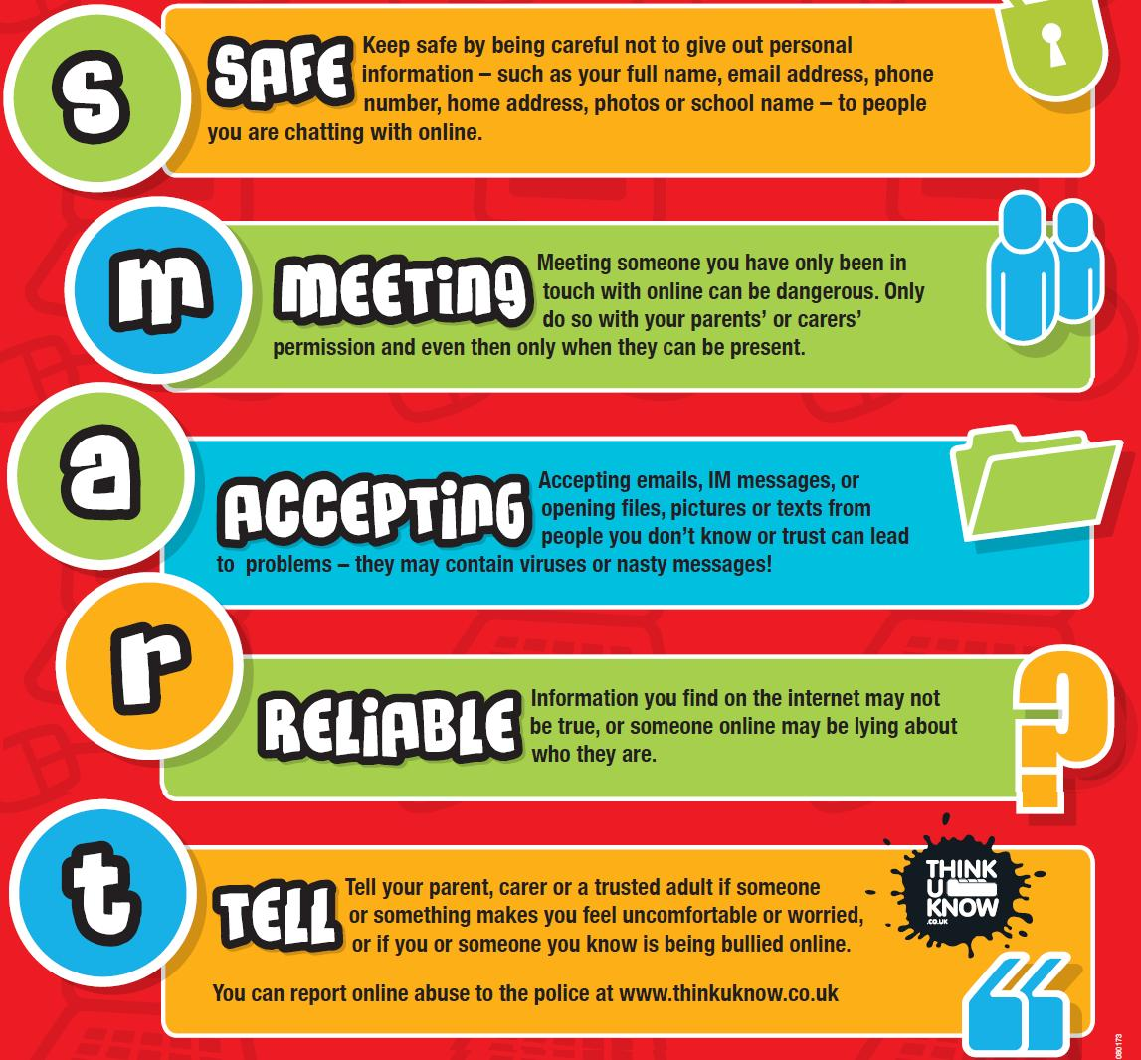
What do we teach the children at Uplands?

Slide 5
What can I do as a parent to help my child stay safe online?
Start young - talk to your child as early as possible. Research shows children in primary school are already experiencing potential dangers online (for example being involved in inappropriate online gaming).
Talk about it - make sure your child knows they can talk to you about anything they see on the internet, or if contact with someone online makes them feel uncomfortable.
Report it! - use the report abuse buttons on social networks to report cyberbullying or inappropriate material/images. Make sure your child knows how to use them too. We are here to help too!
Use parental controls - these let you block certain sites or content so your child can't access it. Look out for gadgets with child-friendly software or ‘kids-mode’ apps and contact your internet provider to find out how they can help.

Slide 6
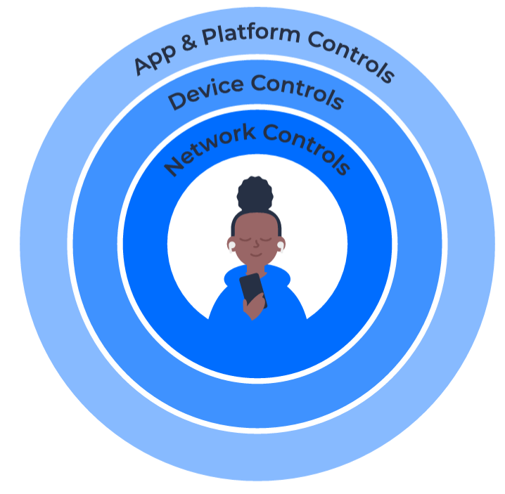
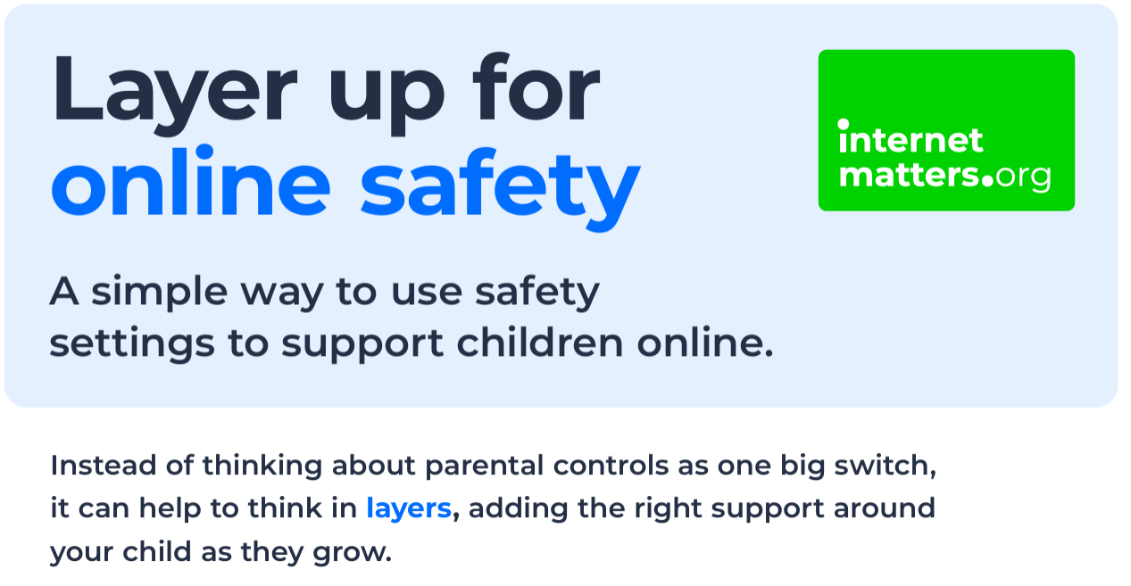
There is lots of support out there
https://youtu.be/6mXO5YOEeyI?si=X6o2HP70aj9UVEGr

Slide 7
Where can you go for support?
https://www.internetmatters.org/
https://www.internetmatters.org/parental-controls/
https://www.gov.uk/government/publications/...keeping-children-safe-online
https://www.nspcc.org.uk/keeping-children-safe/online-safety/
https://nationalcollege.com/library... parent guides
https://www.childnet.com/young-people/4-11-year-olds/get-smart/

