Slide 1
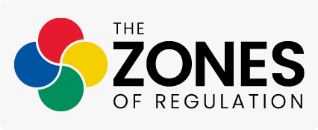

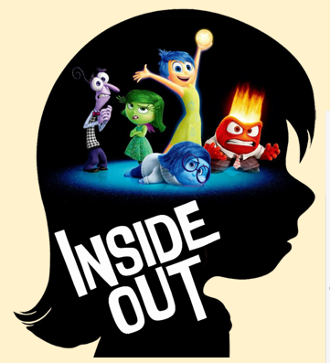
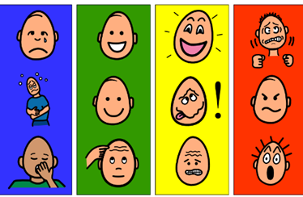
7th May 2026

Slide 2
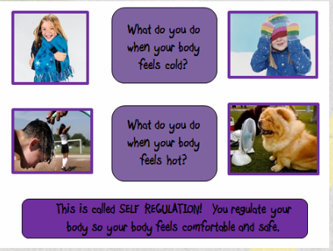


What is self regulation?
The ability to focus your attention, control your emotions and manage your thinking, behaviour and feelings.

Slide 3
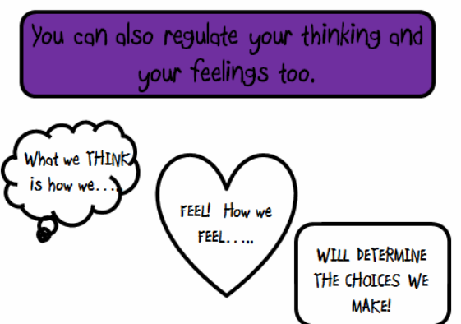


Slide 4
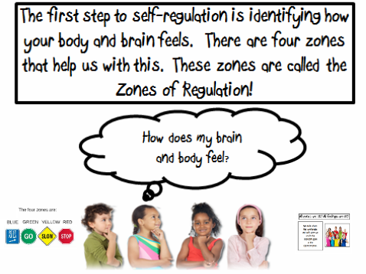

Slide 5
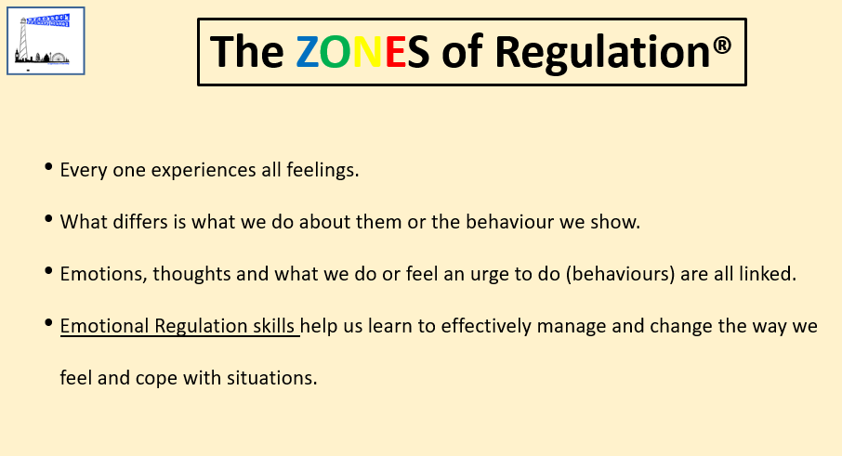

Slide 6
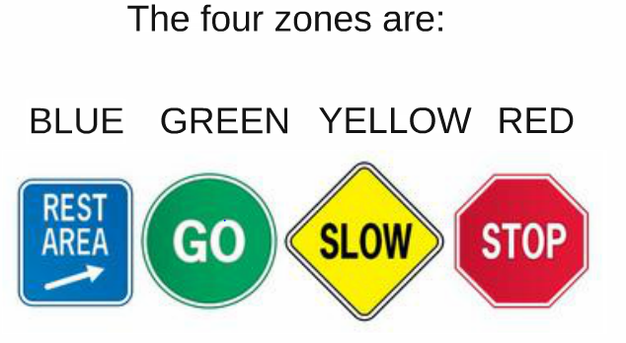
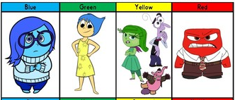

Slide 7


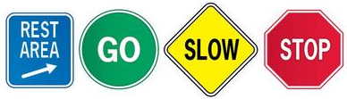

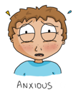

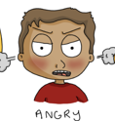
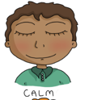
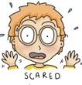
The Yellow Zone is also used to describe a heightened state of alertness and elevated emotions, however one has more control when they are in the Yellow Zone. A person may be experiencing stress, frustration, anxiety, excitement, silliness, the wiggles, or nervousness when in the Yellow Zone.
The Blue Zone is used to describe low states of alertness and down feelings such as when one feels sad, tired, sick, or bored.
The Red Zone is used to describe extremely heightened states of alertness and intense emotions. A person may be elated or experiencing anger, rage, devastation, or terror when in the Red Zone.
The Green Zone is used to describe a calm state of alertness. A person may be described as happy, focused, content, or ready to learn when in the Green Zone. This is the zone where optimal learning occurs.

Slide 8
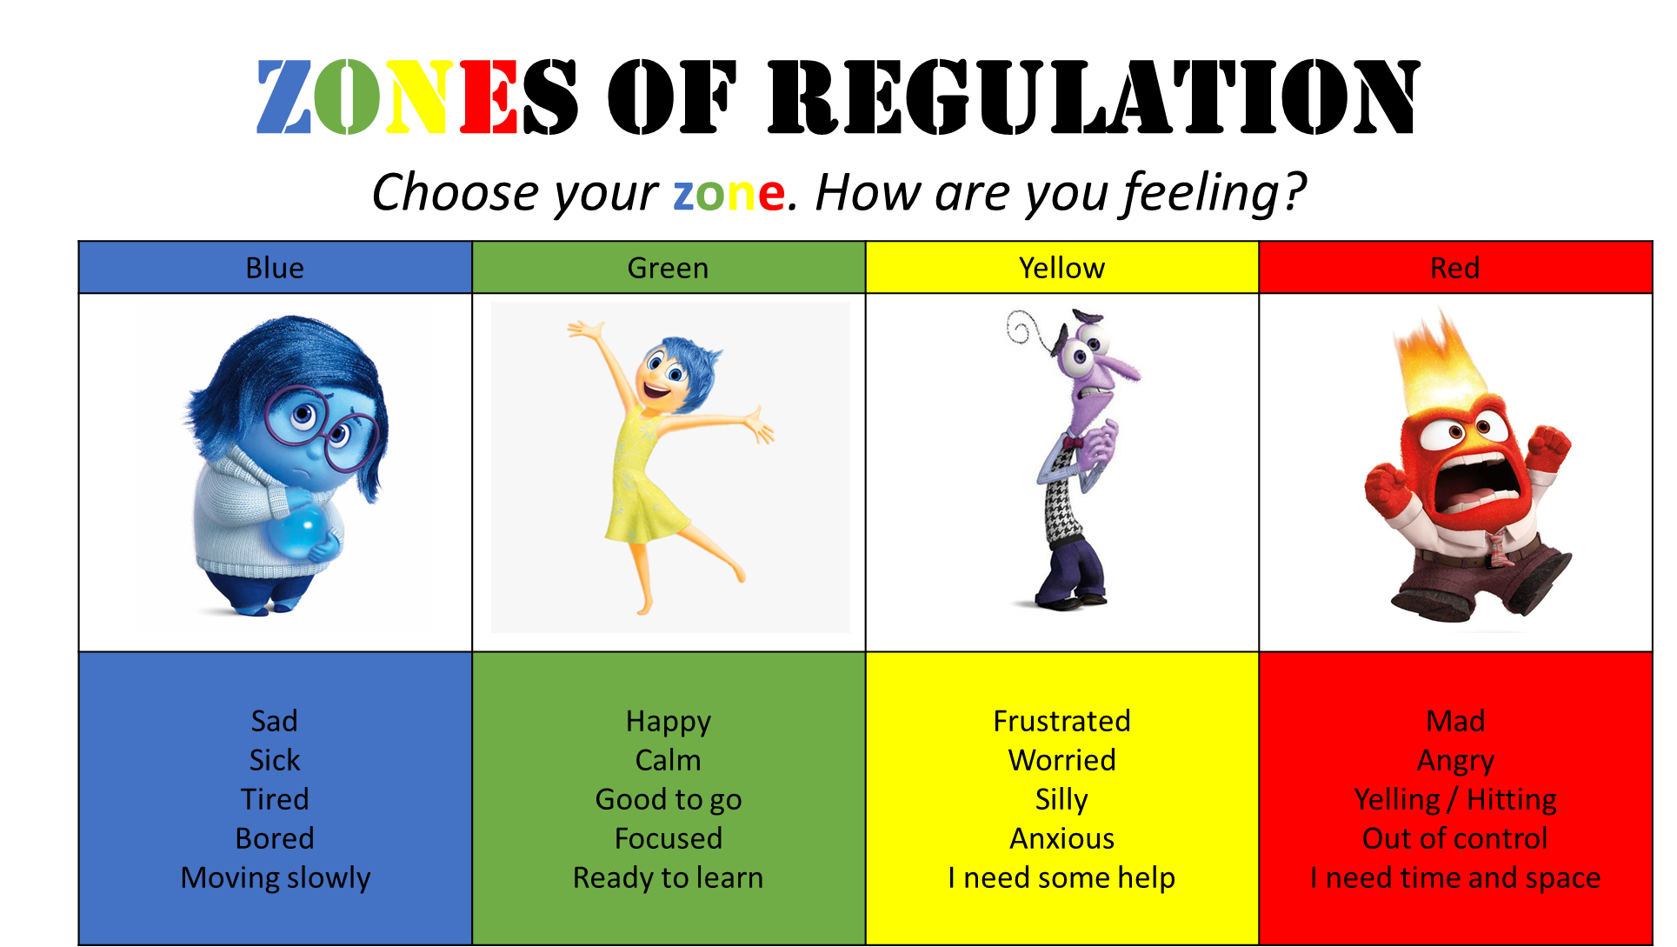
What is it?
The Zones of Regulation is an approach which supports children in managing their feelings.
By categorising the different ways we can feel and states of alertness, children can be supported to identify their own feelings and understand how their feelings can then affect their behaviour.

Slide 9
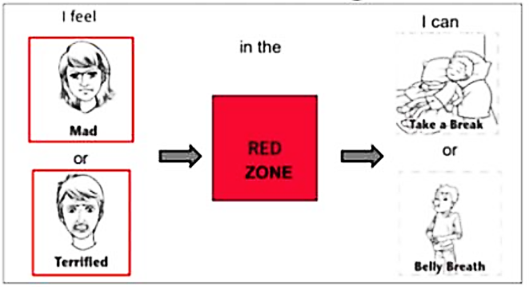
Worth remembering…the Red Zone is not a bad zone!
In fact, none of the zones are bad!
The feelings of anger, terror, devastation etc are perfectly normal to feel but what matters is how children learn to
regulate and manage these strong feelings.

Slide 10
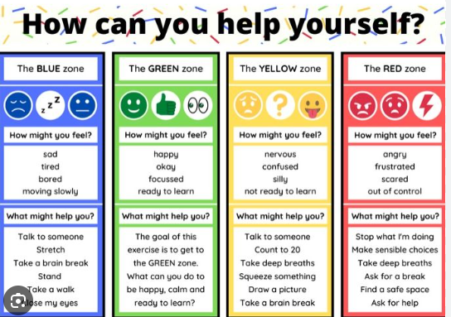

Slide 11

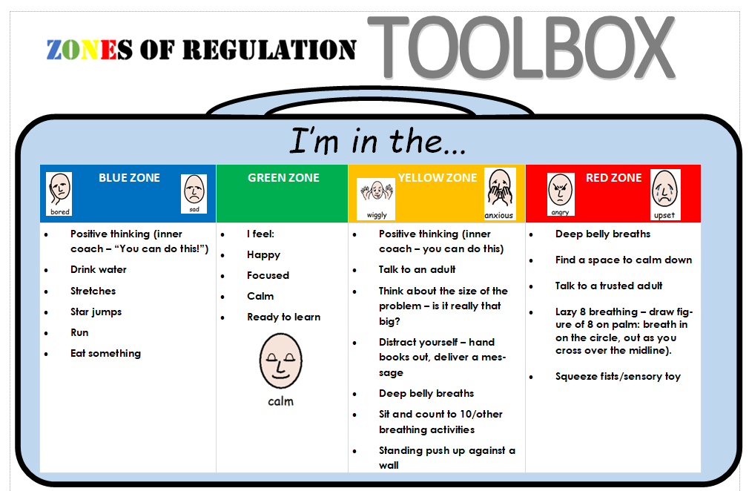
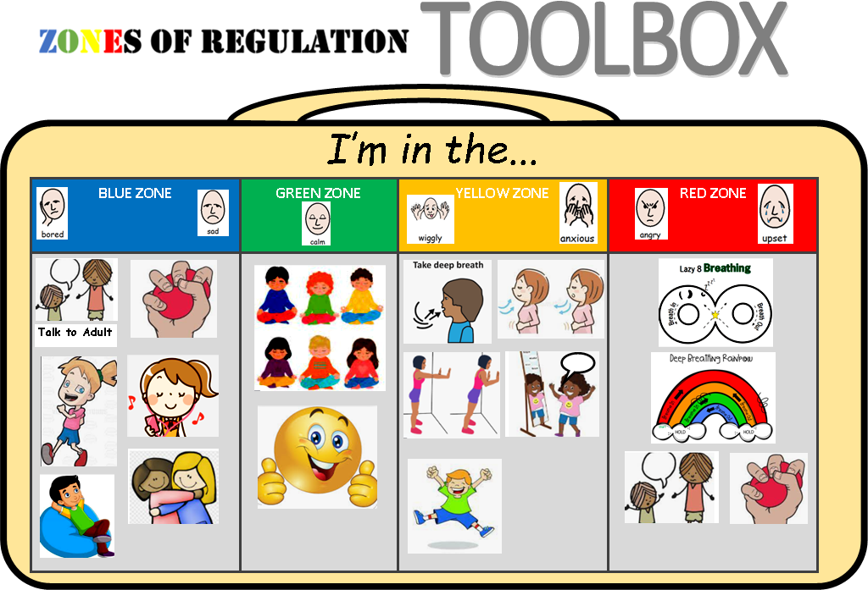
How can we use it at home?
Ask children ‘how are you feeling?’/check in with their feelings.
Identify which zone they are in. ‘Which zone are you in?’
Talk through strategies in their toolbox.

Slide 12
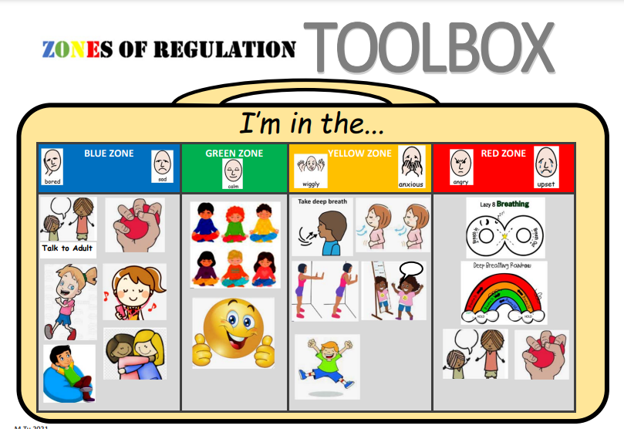

Slide 13
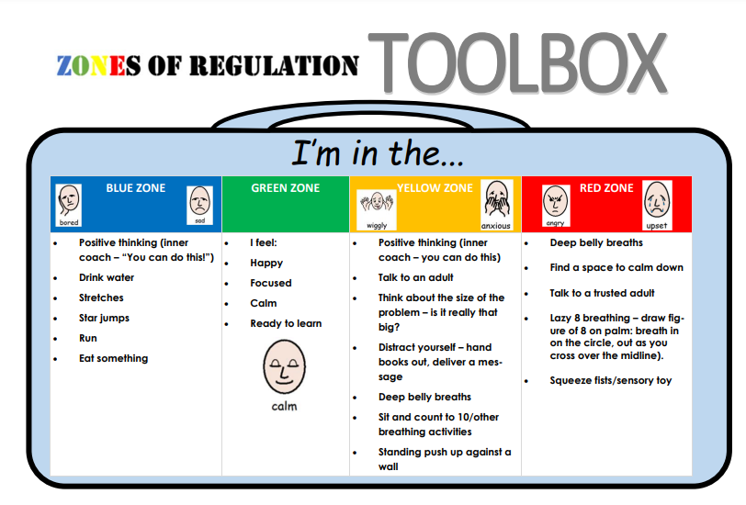

Slide 14


